Slide 1


CAPDEC
CS412 - Computer Vision
Mạch Vĩnh Phát - 20125104
Đào Nhật Quang - 20125108

Slide 2
MODEL OVERVIEW

Slide 3

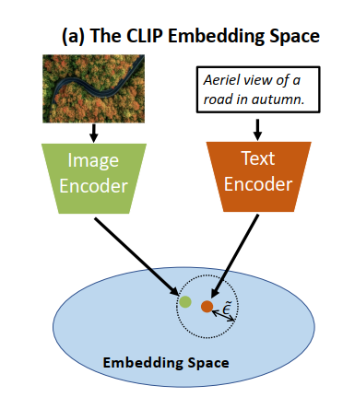

An illustration of the CLIP joint embedding space.
Embedded text is relatively close to its corresponding visual embedding, but with a certain gap.

Slide 4
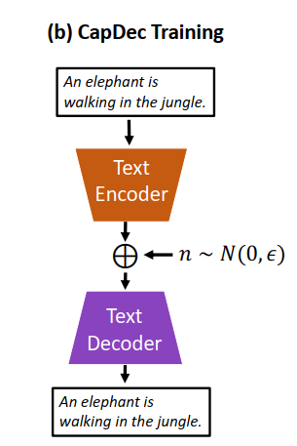
CapDec trains a model that decodes the CLIP embedding of text T back to text T , after noise-injection.
The encoders remain frozen.

Slide 5
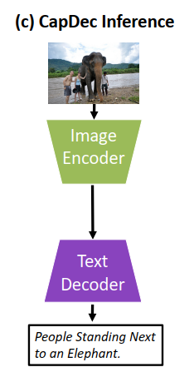
At inference, CapDec simply decodes the embedding of an image using the trained decoder.

Slide 6
EXPERIMENTAL RESULTS

Slide 7
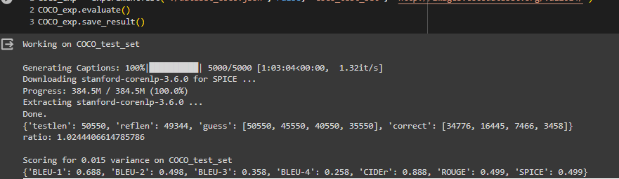
Running on COCO 2014 (0.015 noise)

Slide 8
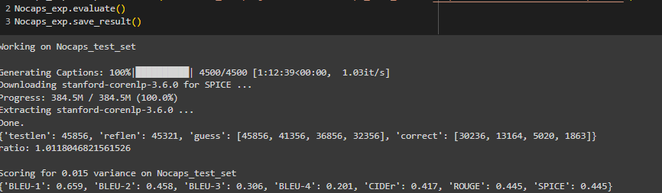
Running on Nocaps (0.015 noise) (working stably)

Slide 9
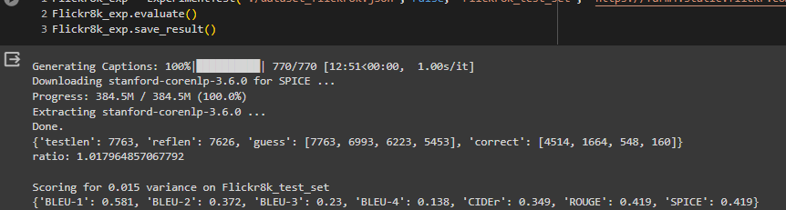
Running on Flickr8k (0.015 noise) (bad generalization)

Slide 10
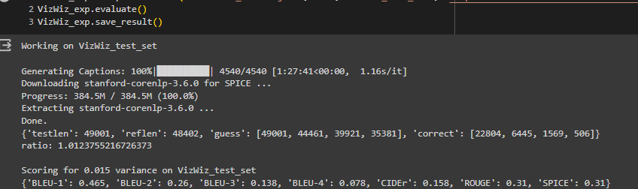
Running on VizWiz (0.015 noise) (bad generalization)

Slide 11
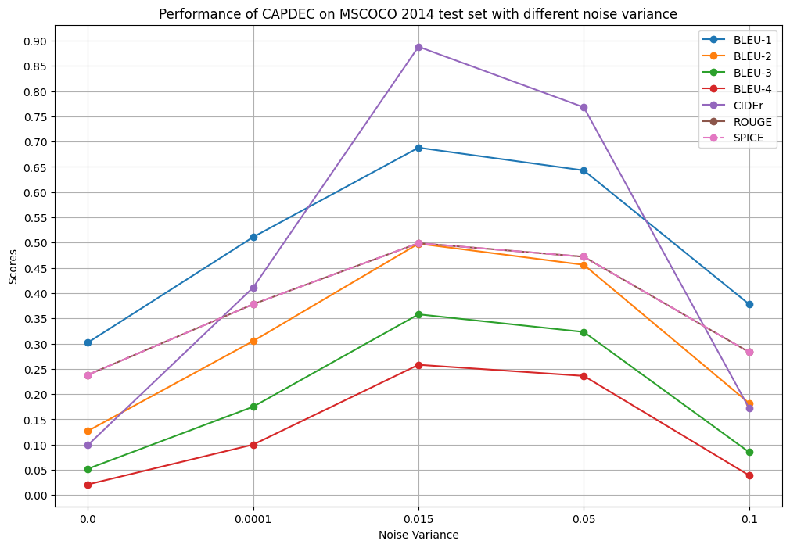
Evaluation on different noise variance (COCO 2014)

Slide 12
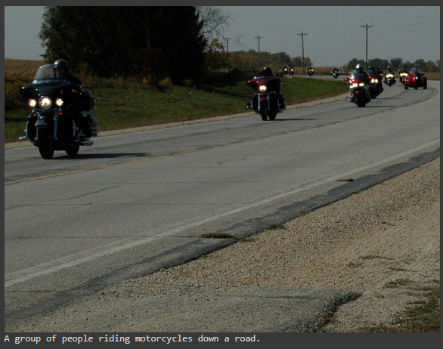
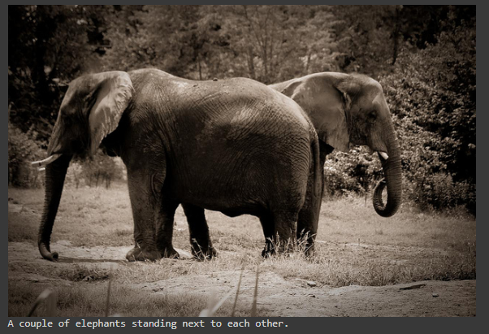
Results

Slide 13
FINE-TUNE

Slide 14
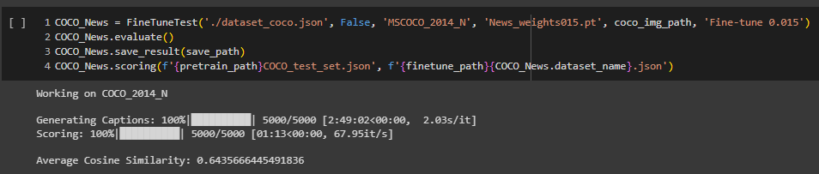
Fine-tuning 0.015 with open-text (News)
Test on COCO

Slide 15
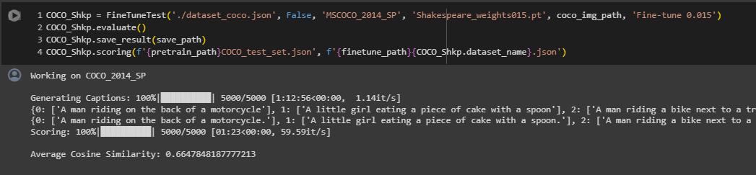
Fine-tuning 0.015 with open-text (Shakespeare)
Test on COCO

Slide 16
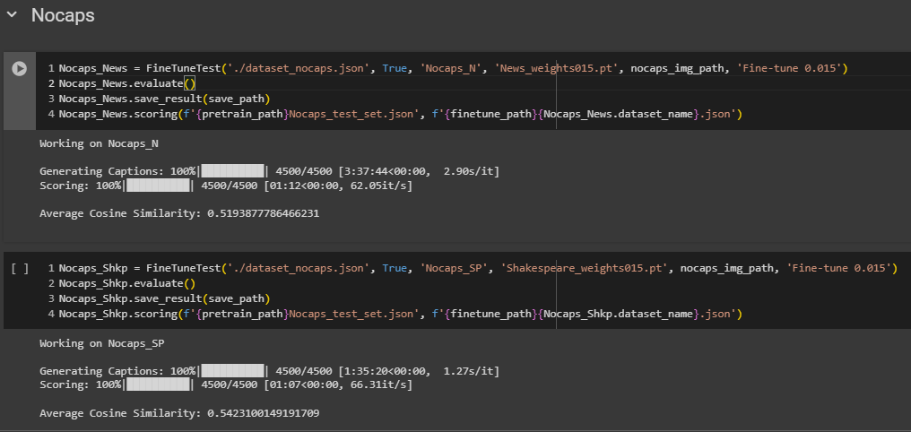
Fine-tuning 0.015 with open-text
Test on Nocaps

Slide 17
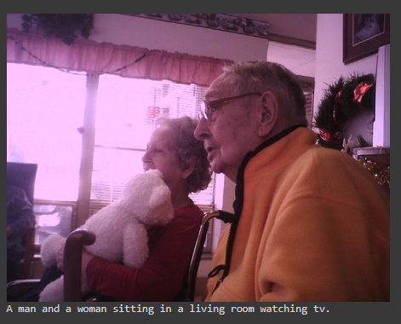
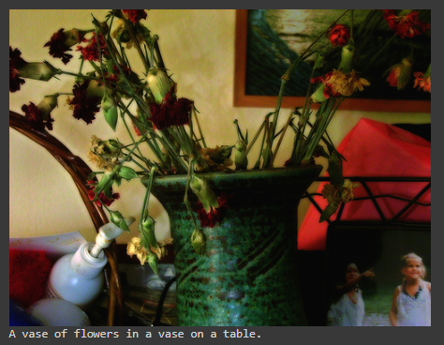
Results
News
Shakespeare

Slide 18
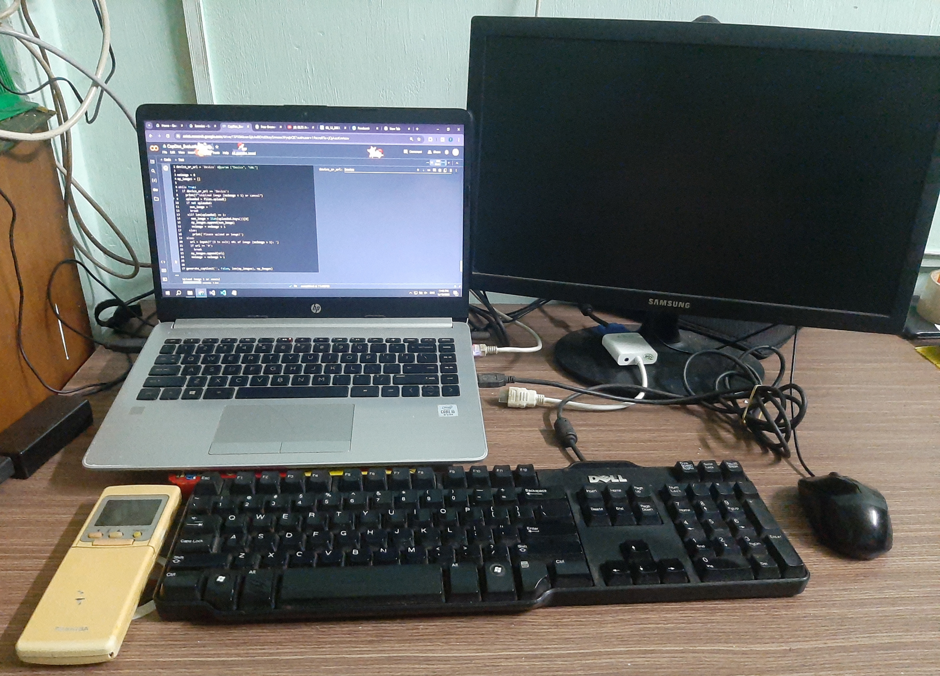
Comparison
Before fine-tuning
After fine-tuning

Slide 19


THANK YOU

